Slide 1
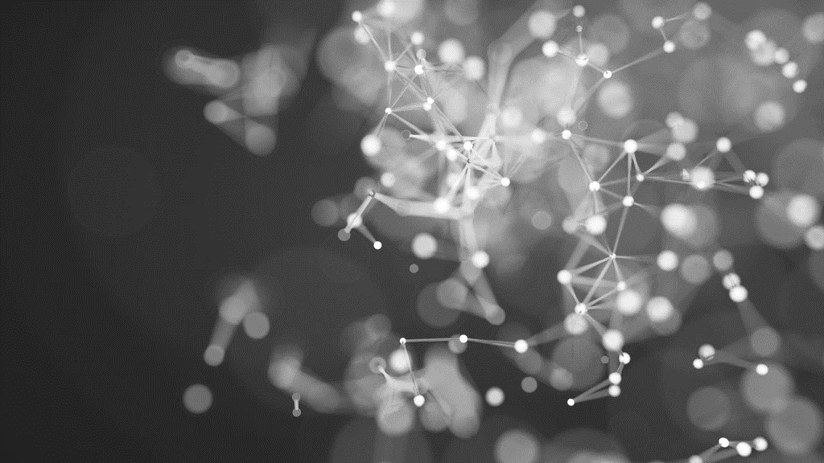
AI based diabetes prediction system
Problem definition and design thinking
9.24.XX

Slide 2

.
Introduction
In this phase, well being developing the diabetes prediction system by preparing the data and selecting relevant features

Slide 3
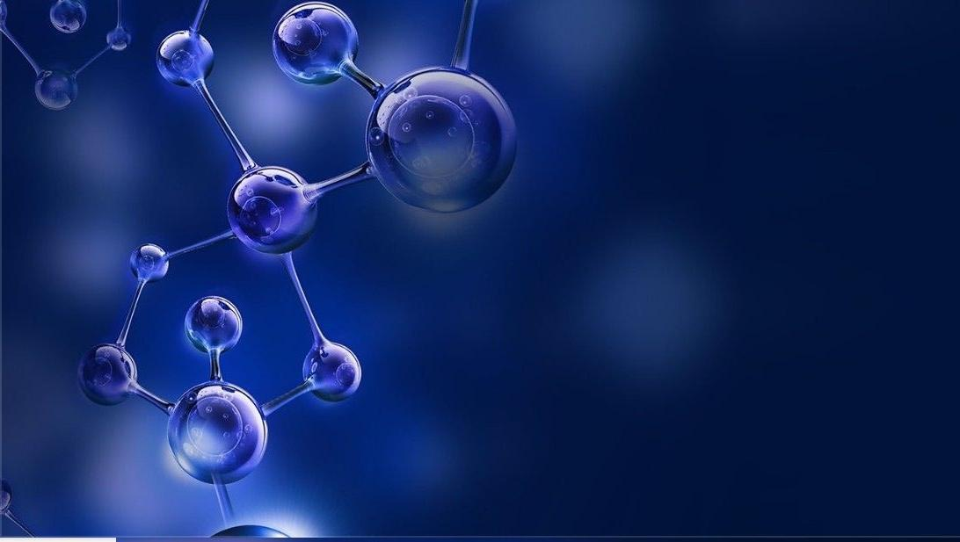
Diabetes is one of the frequent diseases that targets the elderly population worldwide. According to the International Diabetes Federation, 451 million people across the world were diabetic in 2017. The expectations are that this number will increase to affect 693 million people in the coming 26 years
This problem solution to the find the several techniques, there are ;
Naive bayes
probabilistic neural network
Support vector machine
Artificial neural network
TECHNIQUES:

Slide 4

Diagram of predicted technique :
DIABETES PREDICTION TECHNIQUES
NAIVE BAYES
SVM
ANN
PNN

Slide 5

Naive bayes :
Naïve Bayes is a probabilistic machine learning algorithm commonly used for classification tasks, including predicting diabetes.
1. **Data Collection:** Gather a dataset that contains features (such as age, BMI, blood pressure, etc.) and the target variable (diabetes status – either positive or negative). 2. **Data Preprocessing:** Clean and preprocess the data. This may involve handling missing values, normalizing or scaling features, and encoding categorical variables. 3. **Split Data:** Split the dataset into training and testing sets. The training set is used to train the Naïve Bayes classifier, while the testing set is used to evaluate its performance. 4. **Model Selection:** Choose the appropriate Naïve Bayes variant for your problem. For binary classification like diabetes prediction, the Bernoulli Naïve Bayes or Multinomial Naïve Bayes variants are often used, depending on the nature of your .

Slide 6

Support vector machine ( svl) :
Support Vector Machine (SVM) is a powerful machine learning technique that can be used to predict diabetes or other binary classification problems. Here’s a simplified outline of how you can use SVM for diabetes prediction: Data Collection: Gather a dataset that includes features (independent variables) such as age, BMI, blood pressure, and so on, as well as the target variable (dependent variable) which is whether an individual has diabetes or not (typically encoded as 0 for no diabetes and 1 for diabetes). Data Preprocessing: Preprocess the data by handling missing values, scaling features, and splitting it into a training set and a testing set for model evaluation. Feature Selection/Engineering: Select relevant features and perform feature engineering if needed. You may need to normalize or standardize the data to ensure that all features have the same scale. Model Training: Train an SVM classifier on the training data. You can choose from different kernel functions (e.g., linear, polynomial, radial basis function) depending on your data and problem.

Slide 7

Artificial Neural Network ( ANN) :
Artificial Neural Networks (ANNs) can be used to predict diabetes by leveraging their ability to learn complex patterns from data. Here’s a simplified outline of the steps: Data Collection: Gather a dataset that includes relevant information for diabetes prediction, such as patient demographics, medical history, lifestyle factors, and diabetes diagnosis. Data Preprocessing: Clean the data, handle missing values, and normalize/standardize the features to ensure the neural network can work with it effectively. Feature Selection: Choose the most relevant features for prediction to improve the network’s performance and reduce noise in the data. Data Splitting: Split the dataset into training, validation, and test sets to train and evaluate the model.

Slide 8
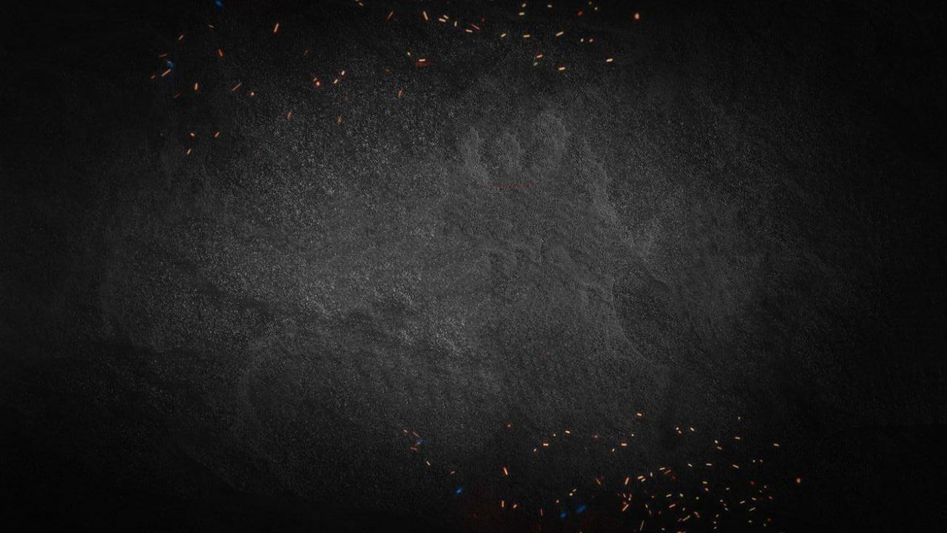
Probabilistic Neural Network ( pNN) :
A Probabilistic Neural Network (PNN) is a type of artificial neural network that can be used for classification tasks, including predicting diabetes. Here’s how you can use a PNN to predict diabetes: Data Collection: Gather a dataset that includes information relevant to diabetes prediction, such as age, weight, family history, blood glucose levels, etc. Data Preprocessing: Clean and preprocess the data to handle missing values, normalize features, and split it into training and testing sets. Network Architecture: Set up the PNN architecture. A PNN typically consists of four layers: input layer, pattern layer, summation layer, and output layer. Pattern Layer: This layer is responsible for storing patterns from the training data. Each pattern corresponds to a class (e.g., diabetic or non-diabetic)

Slide 9
Future Extraction :
* Feature extraction refers to the transformation of raw data into a set of discriminative predictors, which facilitates better model performance [21]. Extracting relevant features is considered the most critical and significant task in machine learning-based classification. In literature, there was limited work done on finding a set of highly correlated features responsible for the future development of diabetes. In this study, two novel feature extraction methods have been introduced. A detailed description of each approach is provided in the subsequent subsections.

Slide 10
Statistical wavelet feature :
* In the literature, the features related to the area under the glucose and insulin curve were extracted from raw OGTT data for T2DM prediction [17]. Wavelet-based statistical features such as mean, median, and standard deviation are widely used for biomedical signal analysis and application [24]. Wavelet transformation is ideal for spectral analysis of the signals. However, the discrete wavelet transformation appears to be less efficient for pure stationary signals. Also, due to the redundancy of wavelet basis functions, it is computationally intensive to choose the right mother wavelet [25]. This paper presents a new type of feature extraction scheme, which is inspired by the Haar wavelet transformation. Haar basis is the simplest yet the most widely used wavelet basis [26]. In this transformation approach, coefficients are calculated by taking the pairwise mean of the raw data .

Slide 11
Glucose and Insulin Index Feature :
* The way a person reacts to glucose intake over time dictates how capable their body is at metabolizing glucose. The poor glucose absorption capability of a person indicates that more glucose will remain in the bloodstream over time [22]. The same holds for the person whose pancreas has an inadequate insulin production capacity. The body’s glucose absorption index (BGAI) and insulin production index (BIPI) have been calculated using the concept of the fractional derivative [23]. The fractional derivative of f(x) with respect to x is the function f′(x) and is defined as, f′(x)=f(k)(x)≈f(x+h)−f(x)hlimh→0f(x)−kf(x−h)+k(k−1)2f(x−2h)+⋯hk(1)(2) View SourceRight-click on figure for MathML and additional features.where f(x+h) is h hours’ time delayed form of f(x) . The classical derivative can be extended for any order k in R, i.e., the derivative of order k does not only have to be a non-integer, but also a negative order. We can simplify the above expression by taking the first two terms only and considering time difference at denominator

Slide 12
Thank You

